Slide 1
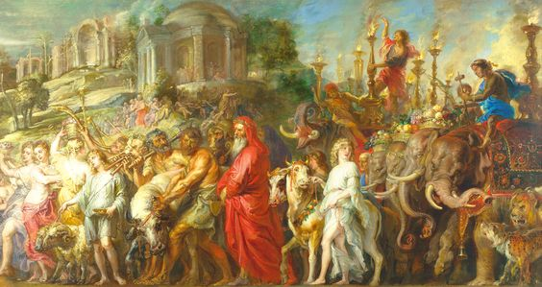
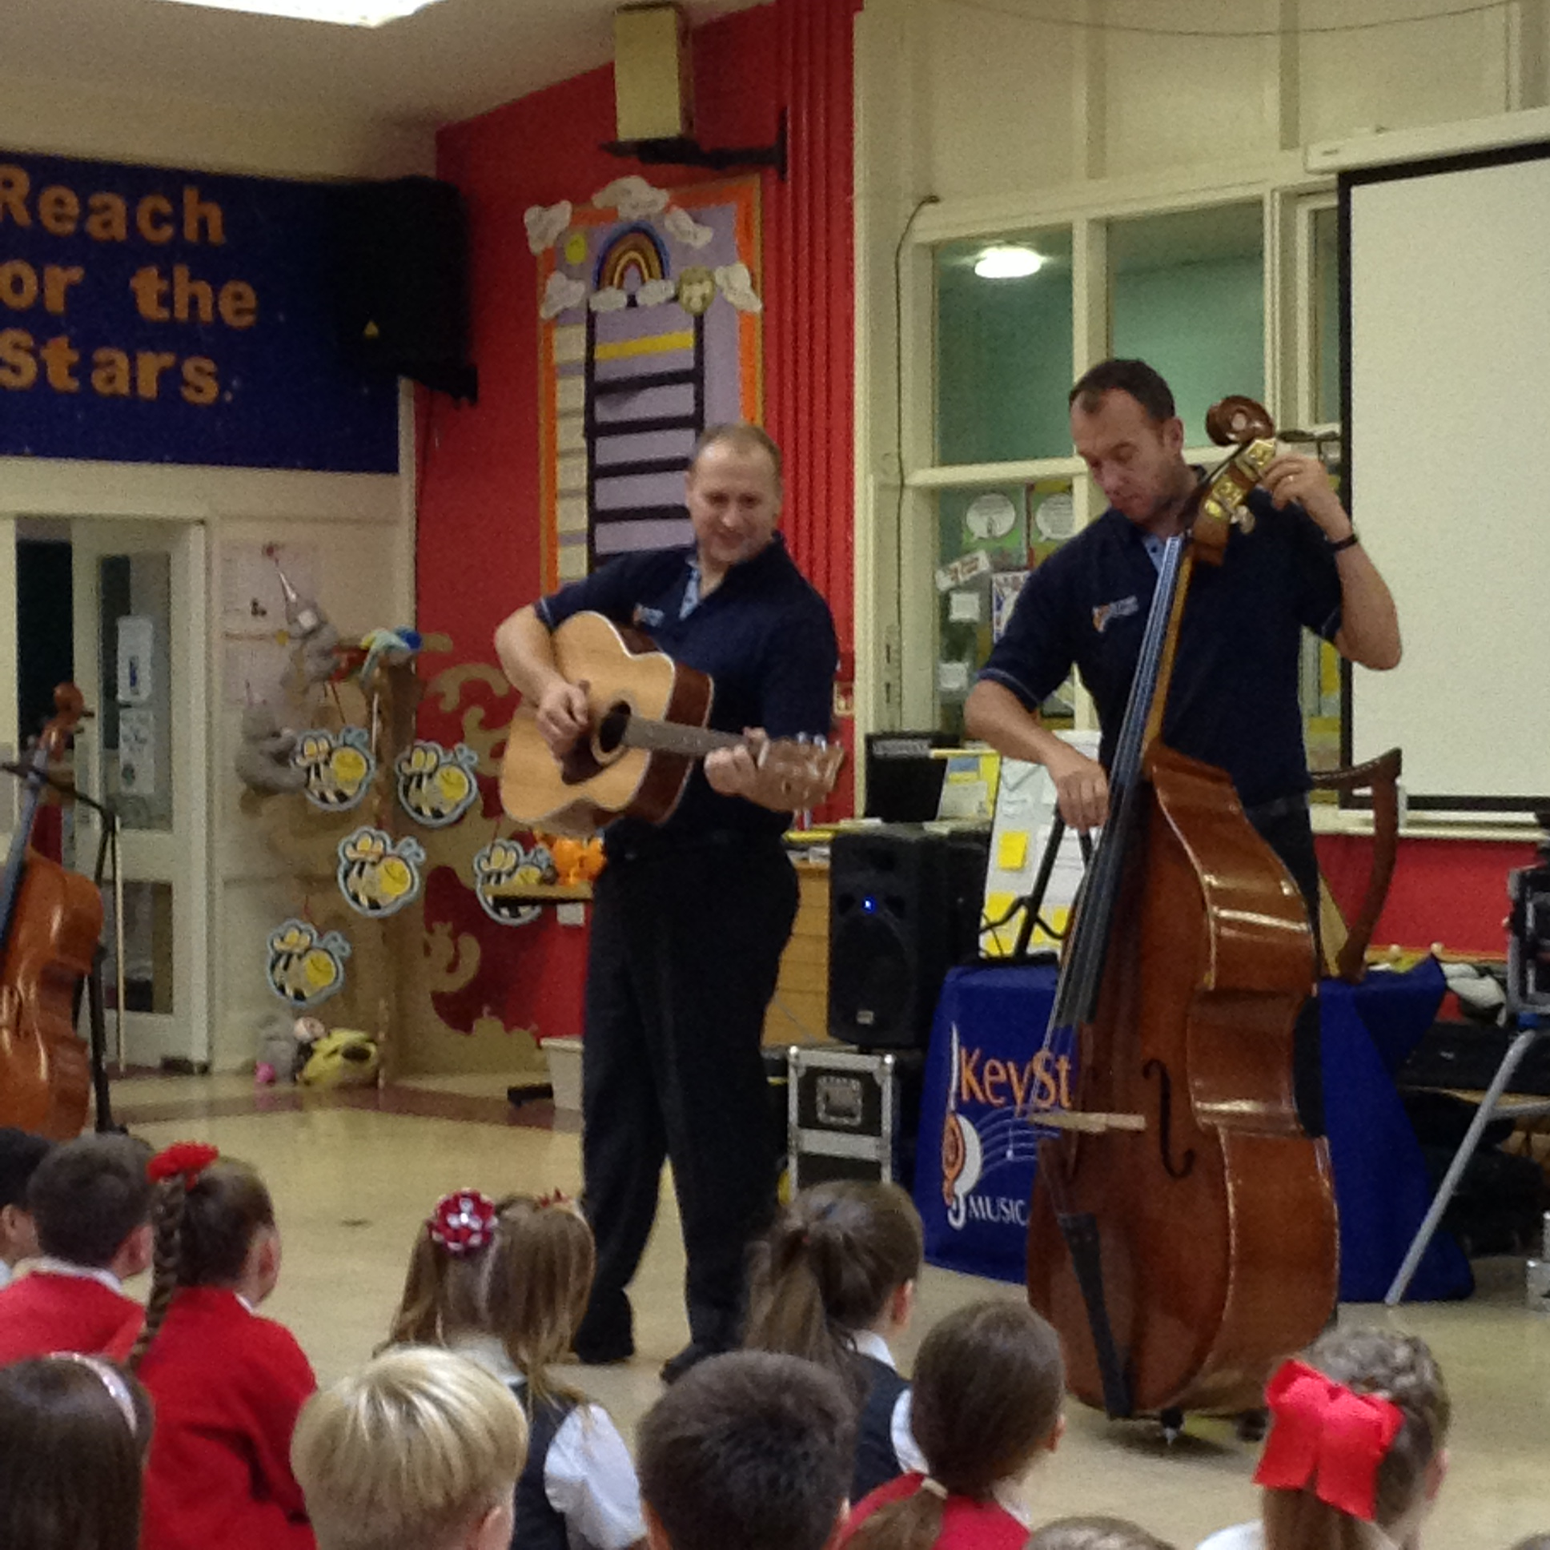
News at Six
Member of the Asscoiated Press . Aenean commodo ligula eget dolor. Aenean. Aenean commodo ligula eget dolor. Aenhswse. Cejhciebce fcdcdcd.
ILLUSTRATED WEEKLY NEWSPAPER
Est. 1869
6th October 2017
Price 6d
Art and Music Days!
Key Stage 2 have recently taken part in two fantastic curriculum days – Art Day and Music Day.
On Friday 22nd September, we had our Art Day. We took part in a variety of activities based upon a painting by Peter Paul Rubens called ’A Roman Triumph’.
These activities included finding out about the artist and the painting itself, making a collage, using clay and painting. Some classes were given a section of the picture (focusing closely on the content), completing a sketch of it, then recreating their own version of the painting.
Other children designed their own elephants (the elephants can be seen on the far right of the painting).
Eva (Y4) said she really enjoyed making the clay elephants, whilst Tom (Y6) explained that his favourite activity was painting.
Music Day took place last Thursday (the 28th September).
The day began with children listening to a variety of music and discussing how the pieces of music made them feel.
This was followed by an amazing performance by “Key Strings’, who took us on a journey through history and around the British Isles. The children absolutely loved this performance!
In the afternoon, all the children went into the hall to make their own musical instrument. The instruments they made were fantastic (I’m sure you will agree), and we finished the day with the children playing their instruments in time to ‘Land of Hope and Glory’.
Jasmine (Y3) said’ I really enjoyed Key Strings coming in”, and Kaila and Kim (Y5), both enjoyed making their own musical instruments.
I am sure you will agree, that the children have worked really hard, but had a great time too!

Slide 2
