Slide 1
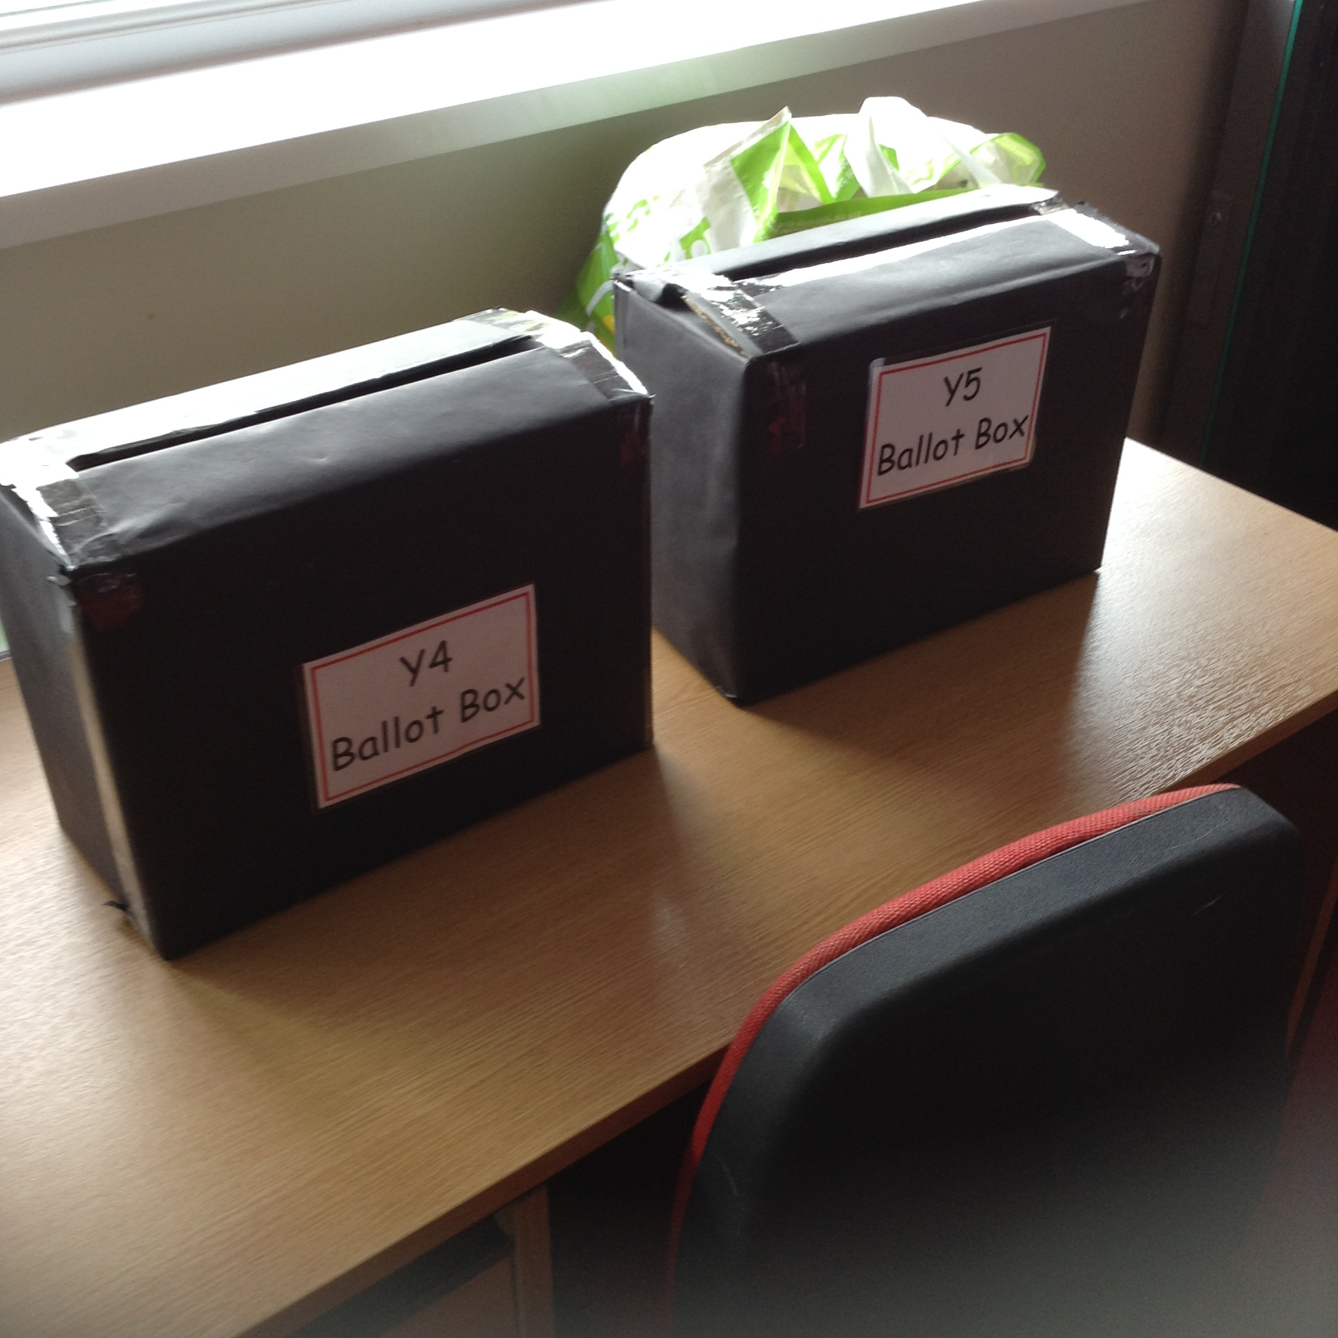
News at Six
Member of the Asscoiated Press . Aenean commodo ligula eget dolor. Aenean. Aenean commodo ligula eget dolor. Aenhswse. Cejhciebce fcdcdcd.
ILLUSTRATED WEEKLY NEWSPAPER
Est. 1869
22nd September 2017
Price 6d
Welcome
Captains and Vice-Captains 2017.
Last week was very exciting in school. All of the children, from Year 1 to Year 6, took part in Knowsley Village Captain and Vice-Captain elections.
All of the children wrote speeches saying what qualities they thought they had to make a great Captain for their team.
The Year 6 children then went to each classroom and presented their speeches to the rest of the classes.
Each child was then given a vote for who they thought who make a great Captain for their team.
The votes have now been counted and I would like to welcome our new Captains and Vice-Captains for 2017.
(Please turn over).

Slide 2
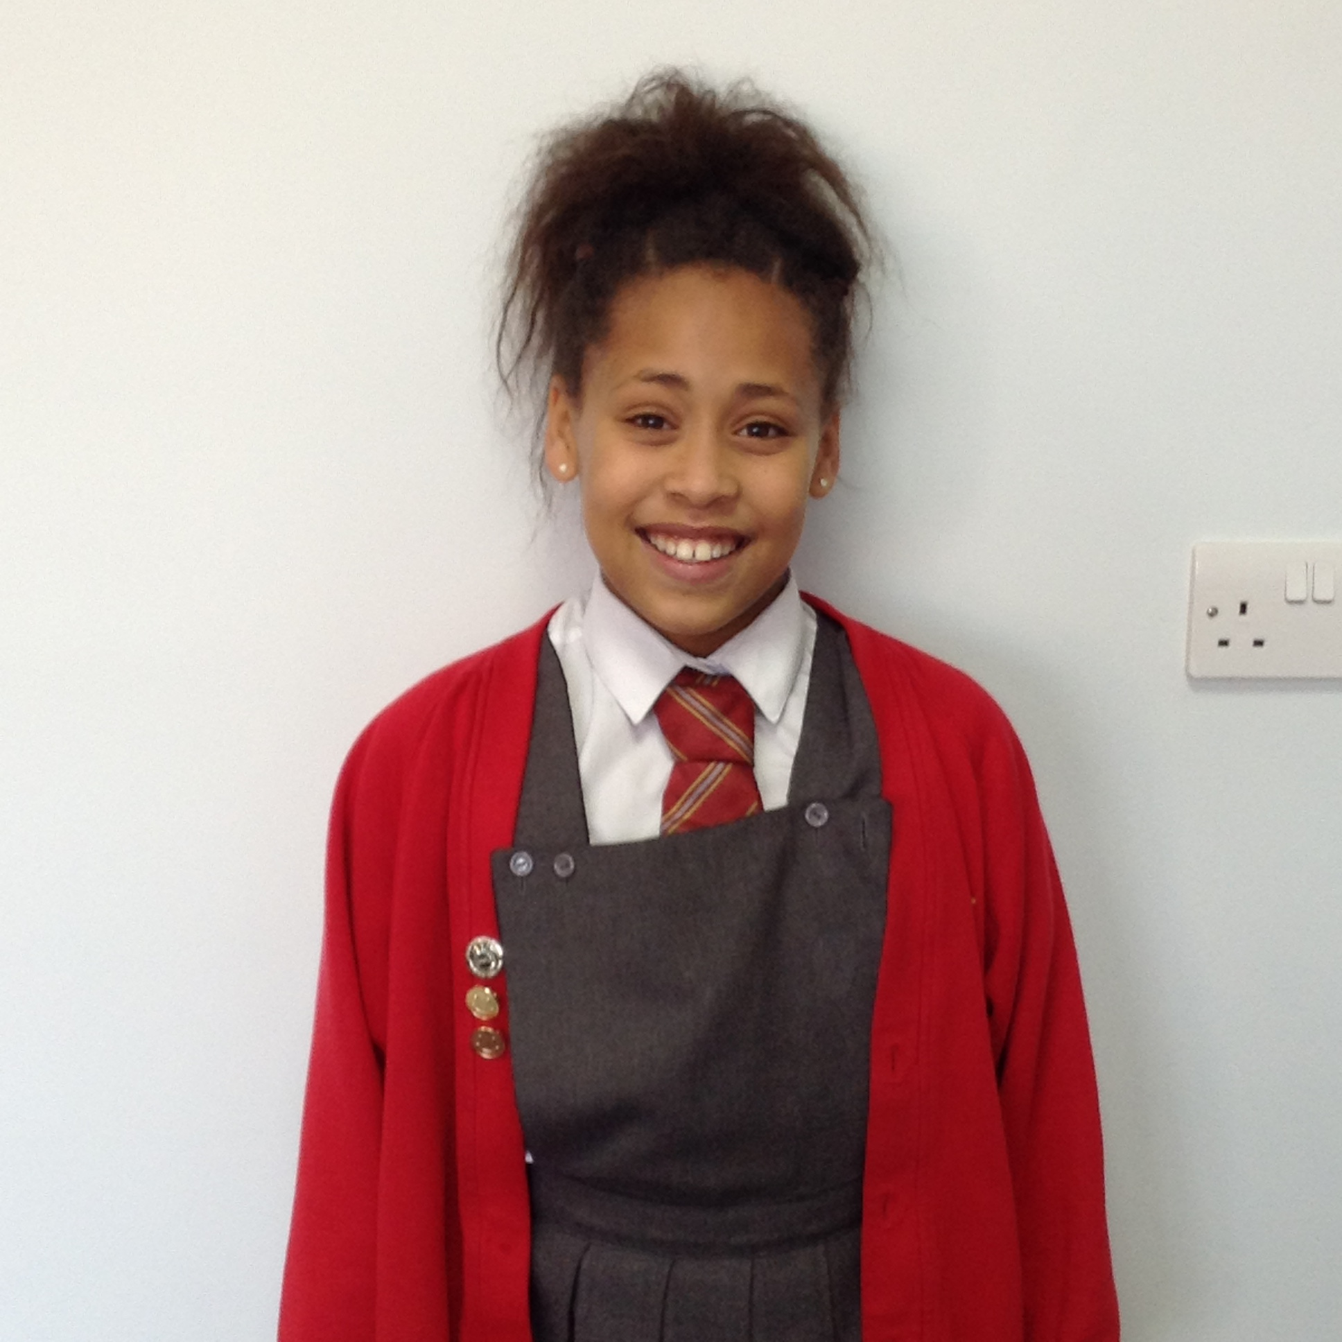
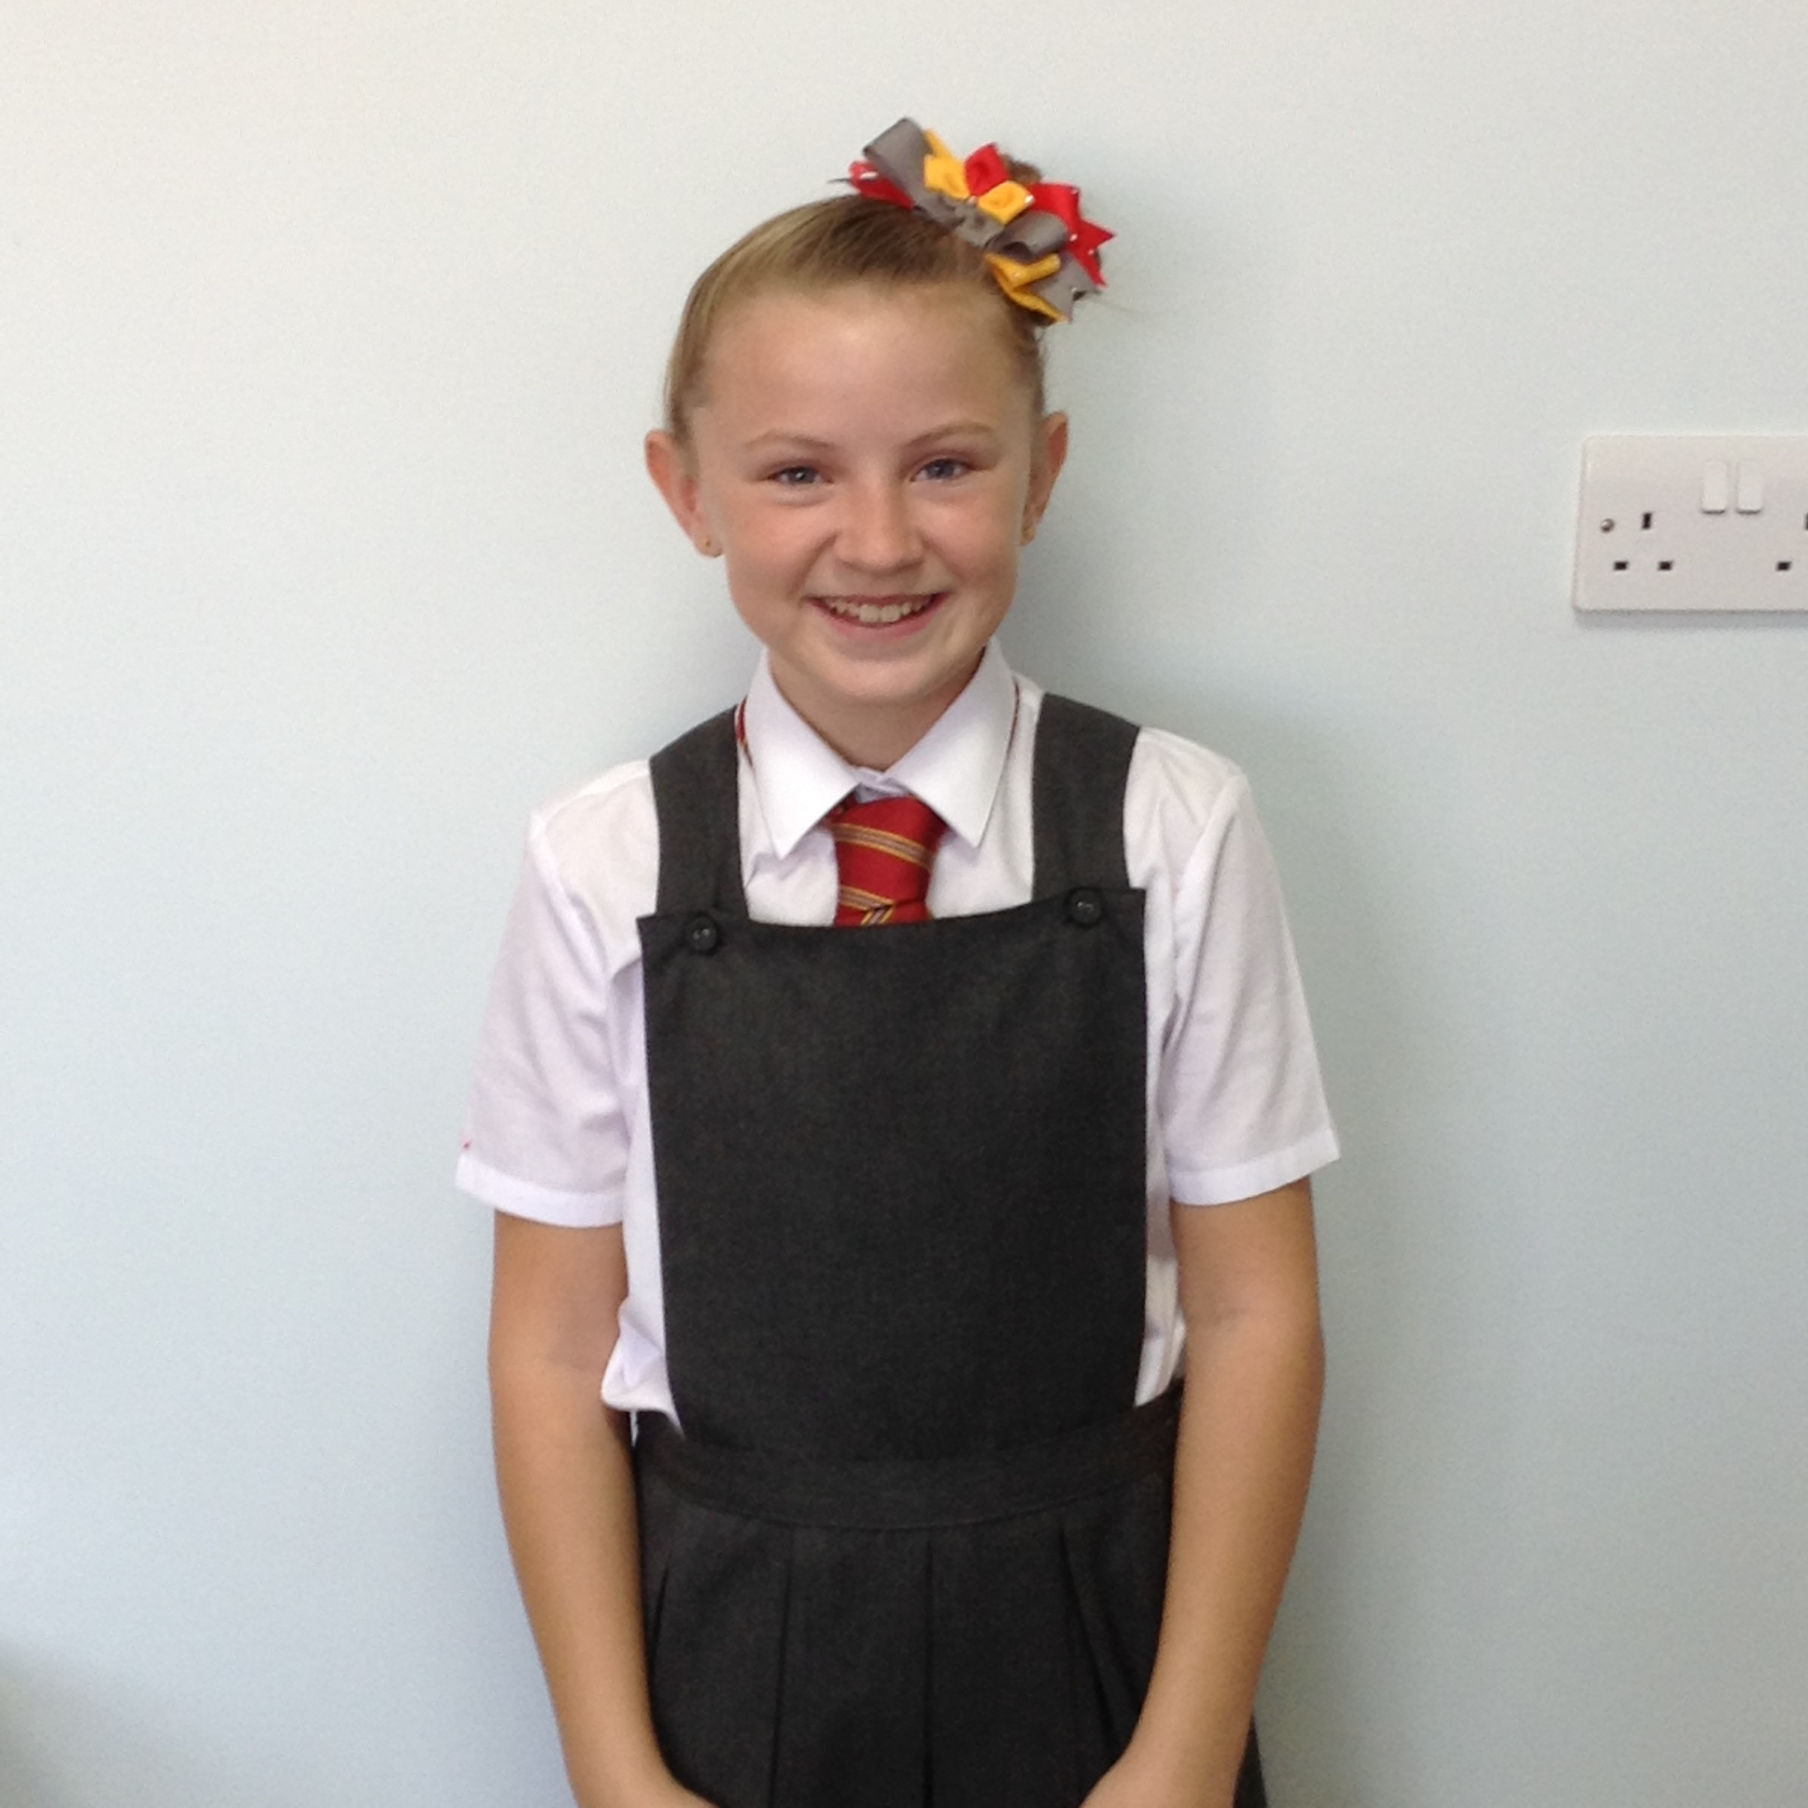
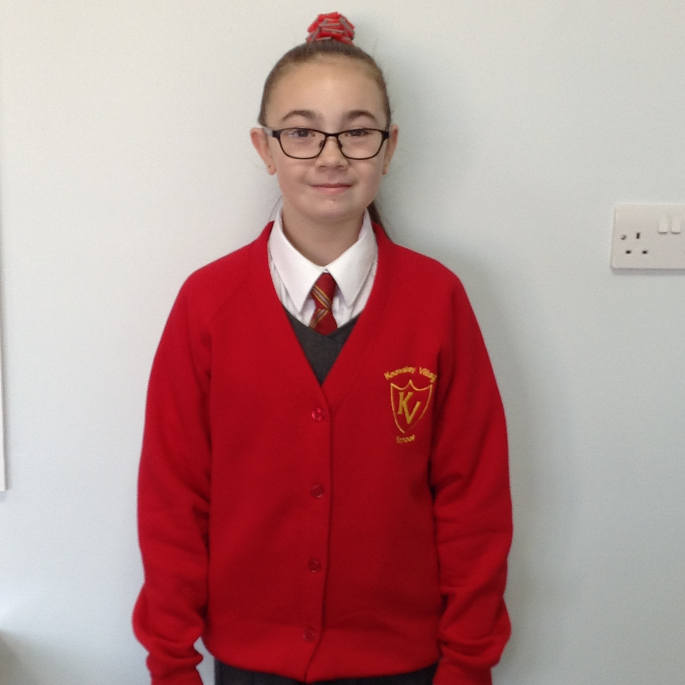
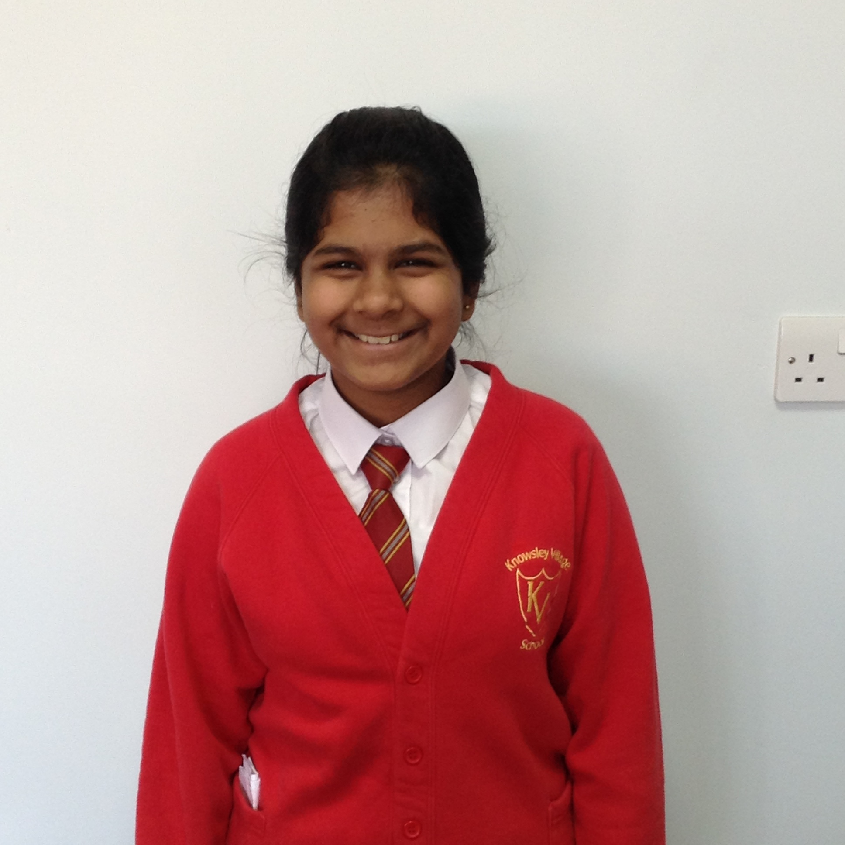
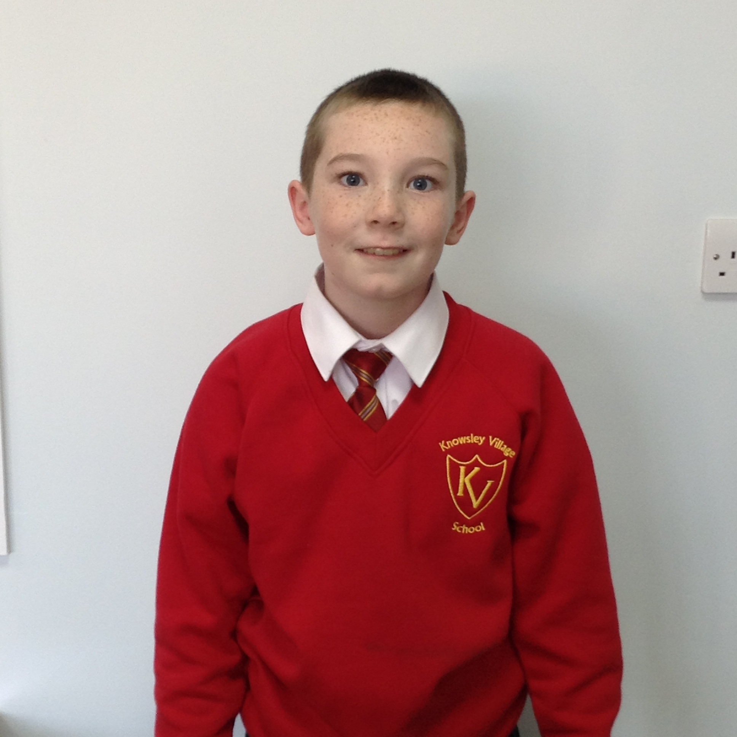
Captains and Vice-Captains 2017.
RUBY – Katie Angell
Callum Holt
EMERALD – Athalia Keesz
SAPPHIRE – Tom Radcliffe
Marcy Campbell
TOPAZ – Ellie Sunners
Katja Sinha

