Slide 1
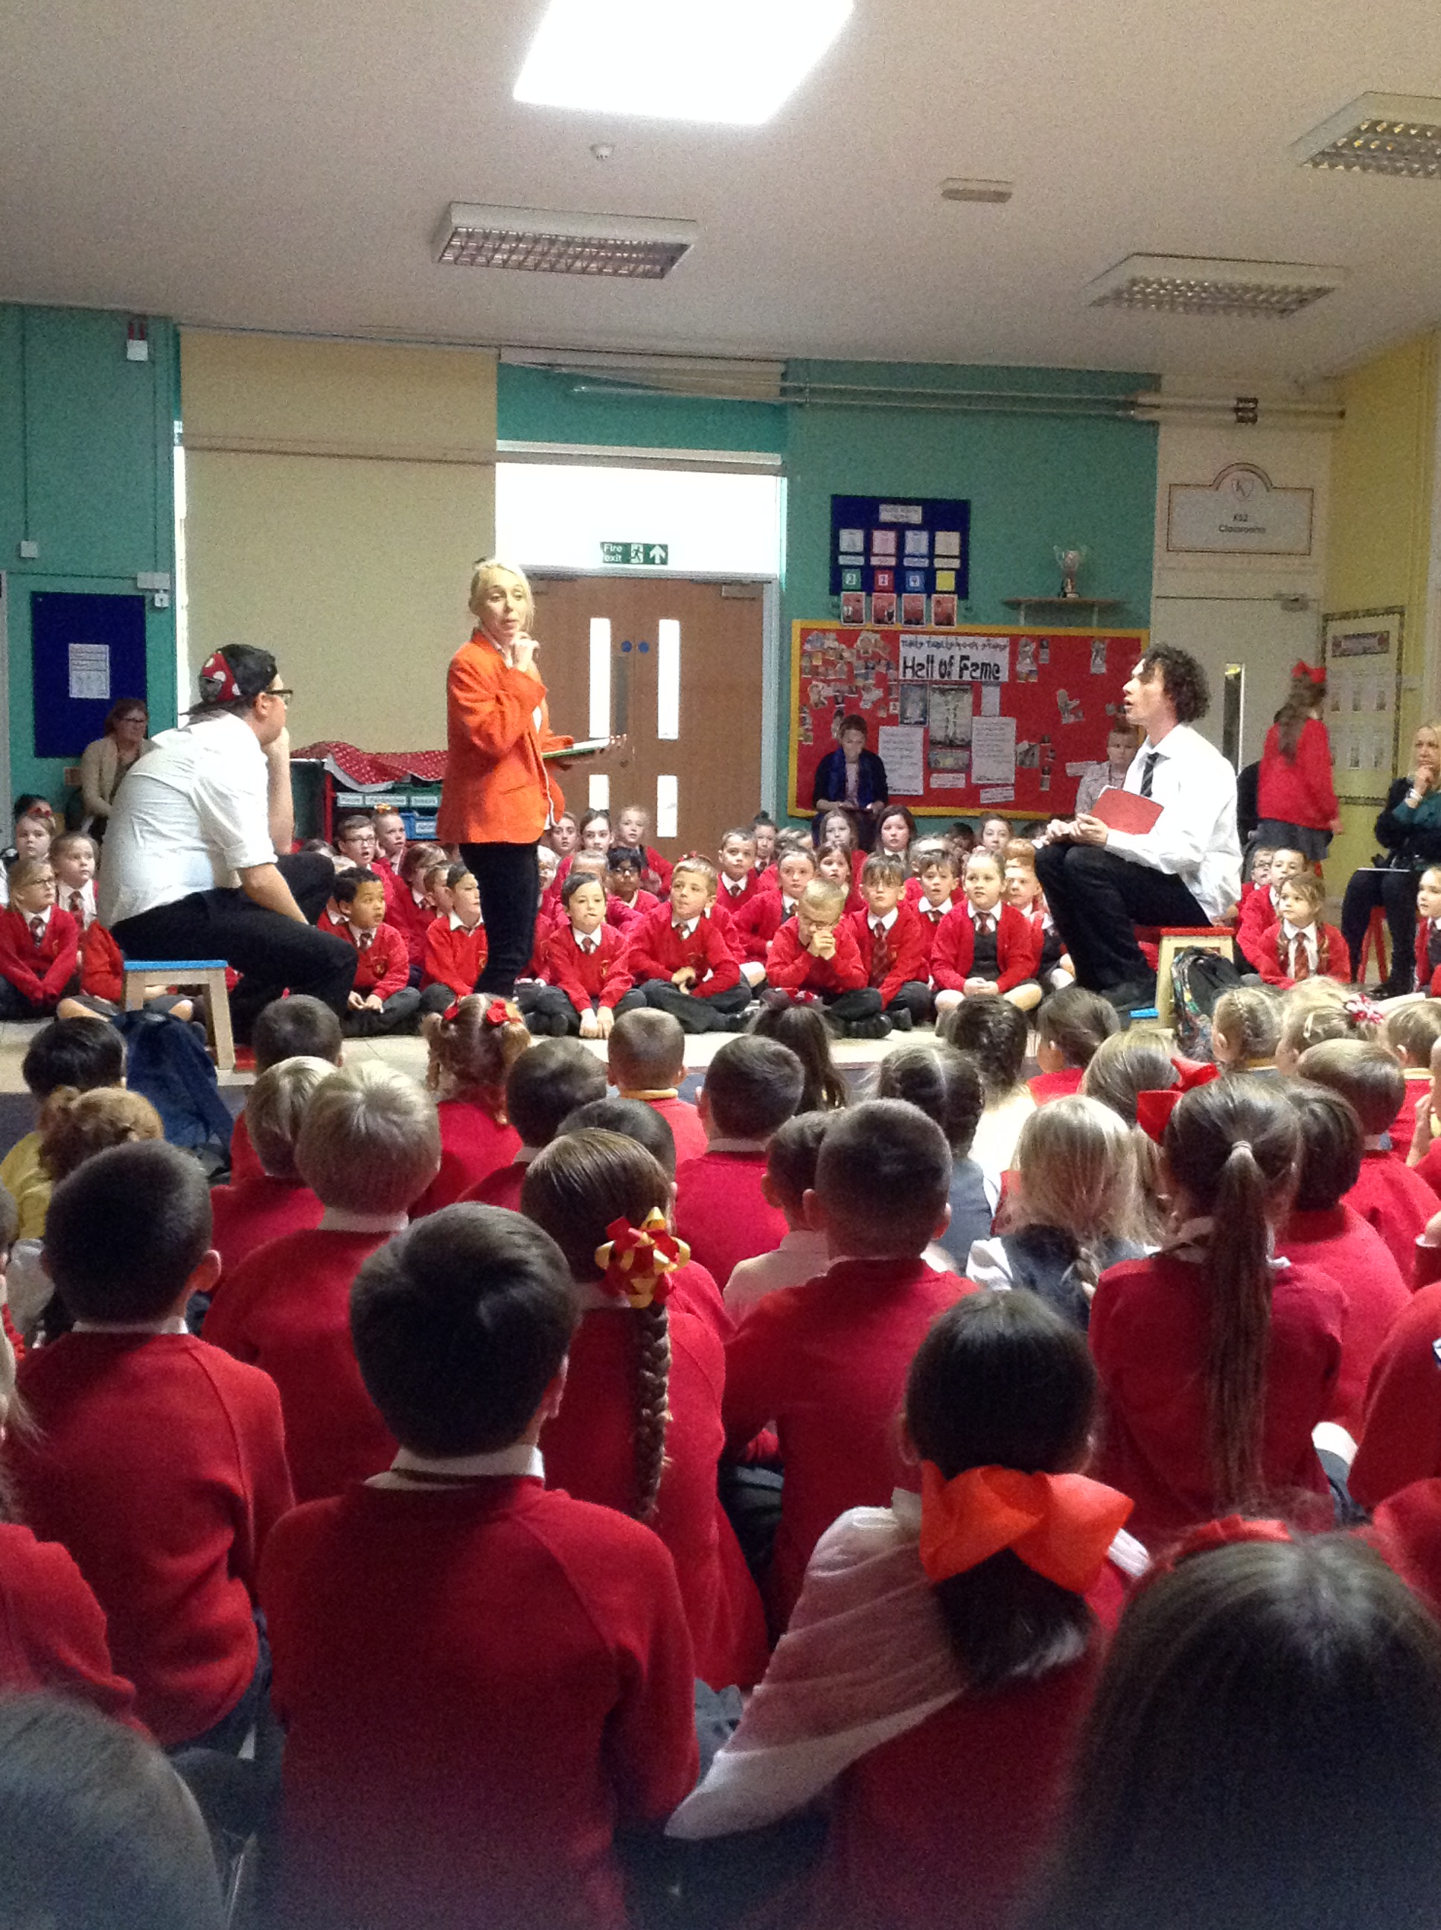
News at Six
Member of the Asscoiated Press . Aenean commodo ligula eget dolor. Aenean. Aenean commodo ligula eget dolor. Aenhswse. Cejhciebce fcdcdcd.
ILLUSTRATED WEEKLY NEWSPAPER
Est. 1869
1st December 2017
Price 6d
Anti-bullying Week!
Recently, all Key Stage 2 children took part in Anti-bullying week. The week started with a drama production, and then each year group took part in a variety of activities.
Anti-bullying week began when the Altru Drama group came into school and performed a play called ‘Superhero School’. All of the children thoroughly enjoyed it and learnt a great deal about how to deal with any issues of bullying.
YEAR 3:
Year 3 thought carefully about what made a 'super-friend' as part of anti-bullying week. They also came up with a list of 'Random Acts of Kindness' that would help to make our school a happier place. They also made e-books about what to do if you are being bullied.
YEAR 4:
Year 4 talked about kindness and the ripple effect it has. They also designed a mask and wrote words to describe what makes a good friend. Year 4 also created a comic about bullying and how to prevent it.
YEAR 5:
Year 5 created their own superhero friend during anti bullying week, and also made a comic strip based on the play they had watched by Altru Drama group.
YEAR 6:
Year 6 completed a variety of activities during the week. These included creating some short plays, demonstrating how to help when bullying occurs, and they then completed comic strips (based upon their own short plays).
I am sure you will agree, that the children worked really hard last week, and learnt a lot too!

Slide 2
