Slide 1
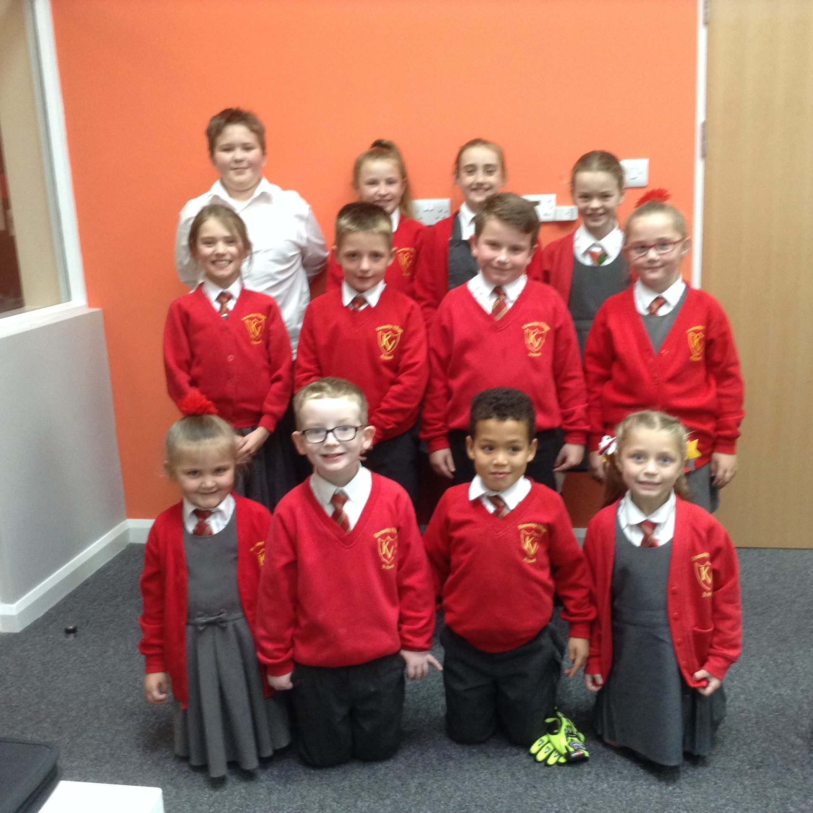
Knowsley village news.
School Council.
Maths morning.
Outdoor classroom afternoon.
Welcome to our School Council Members 2017-2018.
Y1 Connor Holt, Amelia Mingaud
Y2 - Othniel Keesz, Crystal Blackshaw
Y3 - Jasmine Mingaud, Billy Patterson
Y4 - Eva Wardle, Patrick Hogan
Y5 - Lilly Rodriguez, Tillie Haddley
Y6 - Kyle Dodd, Ellie Sunners.
A variety of Maths activities took place. All the children thoroughly enjoyed it and had a great time with MATHS!
Nursery made dough hedgehogs and counted spikes, as they added them to the hedgehogs.
Reception made hedgehogs. The children counted the number of spikes on the hedgehogs and they added up to 10!
Year 1 completed a range of Maths puzzles and problem solving activities. Their favourite activities were 'Picking Apples' and 'Bones'.
Year 2 had to make a tower taller than 1 metre, and go shopping to buy cakes at the cake shop, giving change from 50p,
Year 3 played Maths games, looked for symmetry and completed a Maths investigation.
Year 4 were challenged to create their own geometry village using 3D shapes.
Year 5 played ‘Play your cards right’ and completed Sudoku puzzles.
Year 6 conducted a traffic survey, then created pie charts to show the results.
All of the children had an amazing afternoon exploring our outdoor environment. What an amazing world we live in!
Nursery had great fun making different sized hedgehogs using Autumn leaves and sticks which they had collected from outside.
Reception used leaves to make the shapes of letters of the alphabet.
Year 1 enjoyed observing leaves and created finger-tree autumn trees. They also collected leaves and sticks to create hedgehog pictures.
Year 2 used items they found outside their classroom to make sounds and music.
Year 3 made Autumn wreaths and photo collages.
Year 4 were inspired by the British artist, Andy Goldsworthy, and the children created circle and spiral pieces of art out different natural objects.
Year 5 used leaves, twigs and other things you find outside, to make hedgehogs, and looked for faces in objects found around the school.
Year 6 did some cloud-gazing, tree and leaf rubbings and also made creatures from leaves and twigs.

Slide 2
